Slide 1
Computer Programming Adv
TEKNIK
Basic of JavaScript
Teknik Elektro

Slide 2





Code Editors

Slide 3

Code Editors
Open an IDE
and
Create new file
Named
“index.html”
and
“/js/app.js”

Slide 4
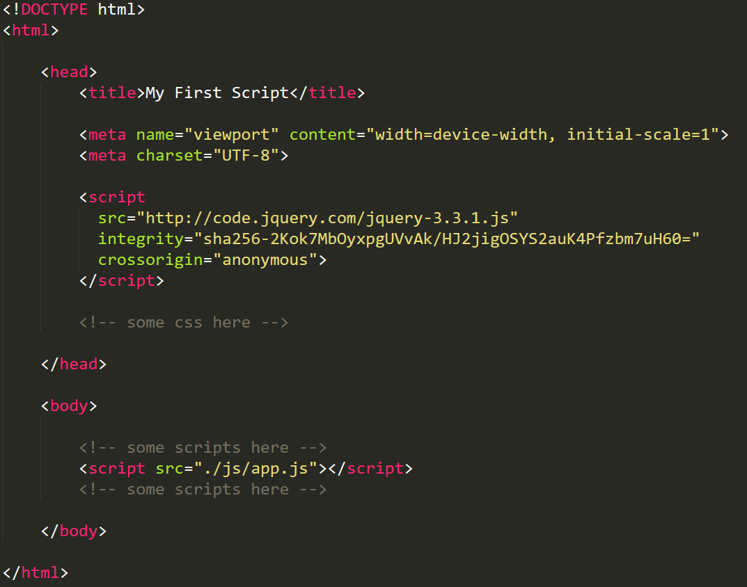
index.html

Slide 5
index.html
<!DOCTYPE html>
<html>
<head>
<title>My First Script</title>
<meta name="viewport" content="width=device-width, initial-scale=1">
<meta charset="UTF-8">
<script src="http://code.jquery.com/jquery-3.3.1.js"></script>
</head>
<body>
<span>this is index.html</span>
<!-- some scripts here -->
<script src="./js/app.js"></script>
<!-- some scripts here -->
</body>
</html>

Slide 6
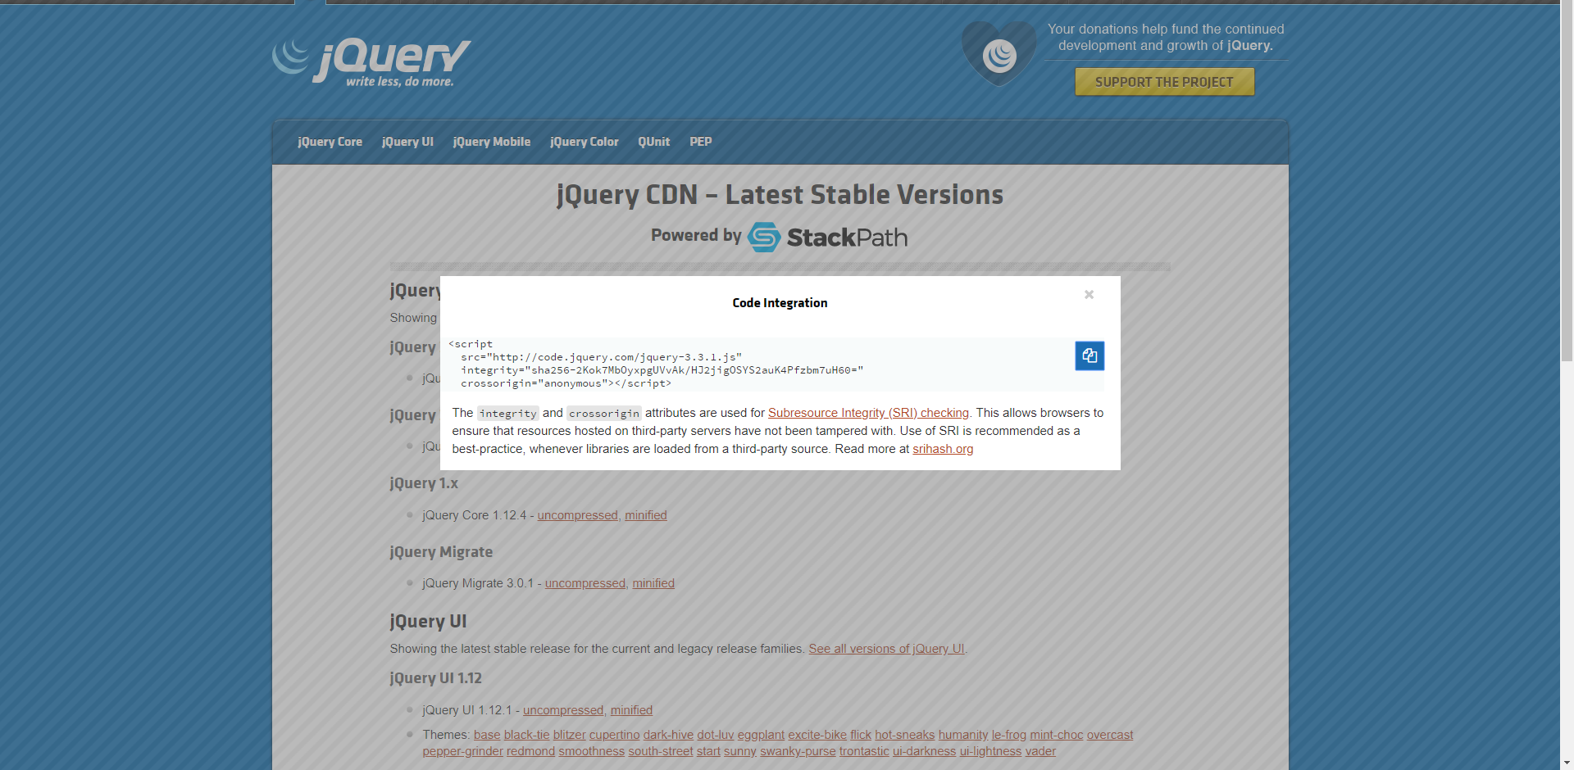
JQuery Lib
http://code.jquery.com/

Slide 7
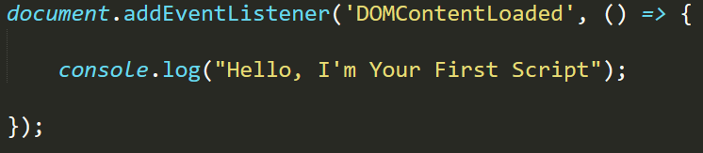
app.js

Slide 8
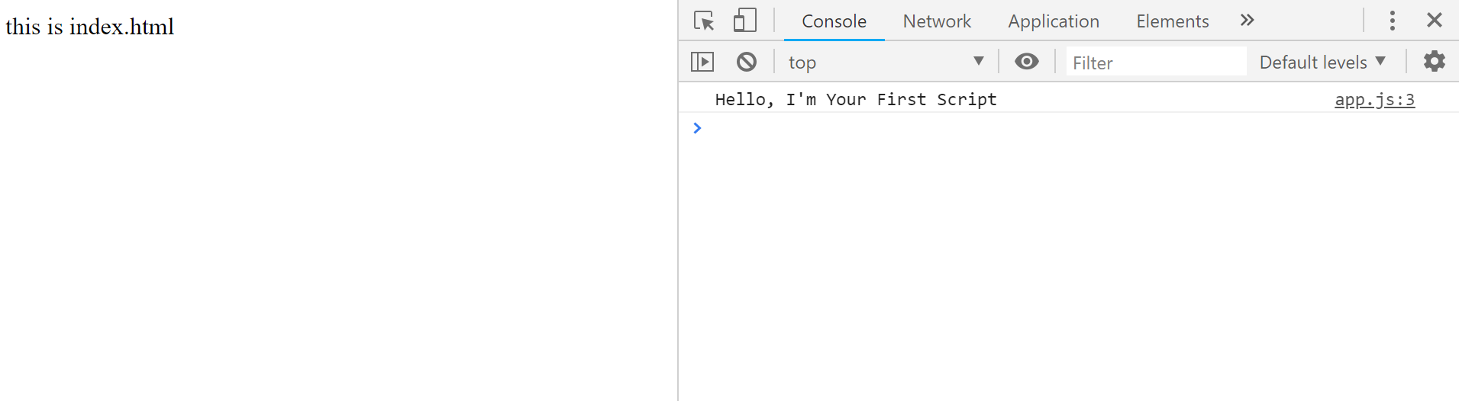
Tab Console

Slide 9
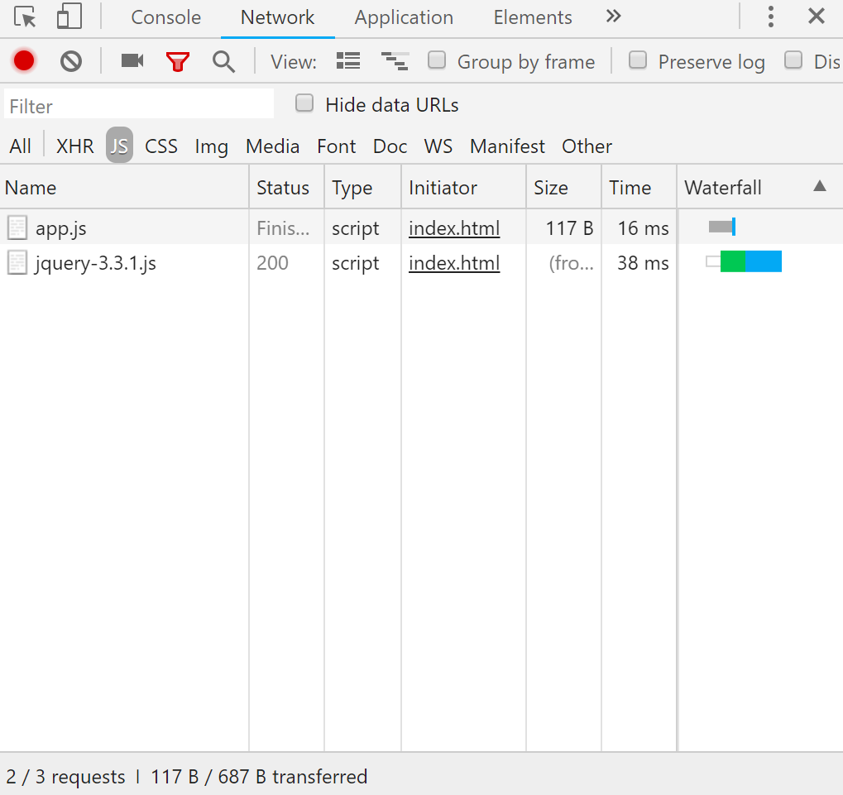
Tab Network

Slide 10
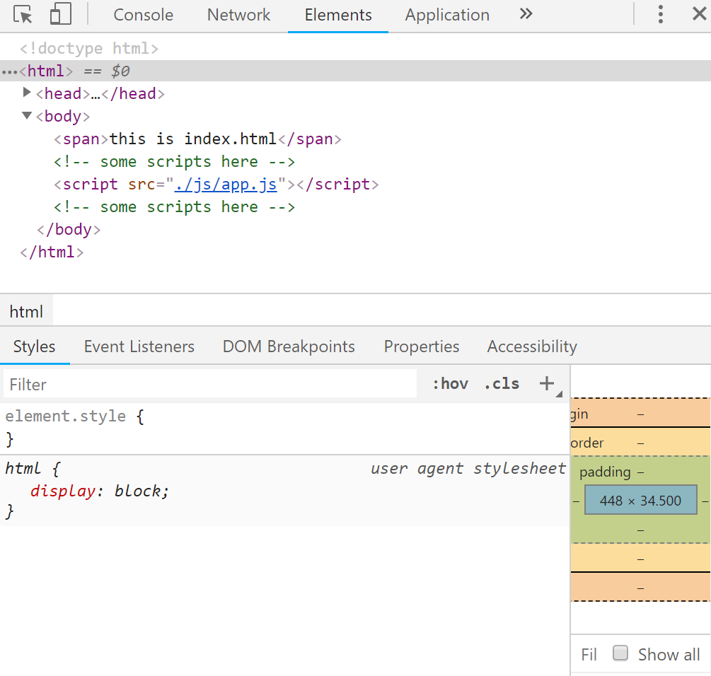
Tab Element

Slide 11
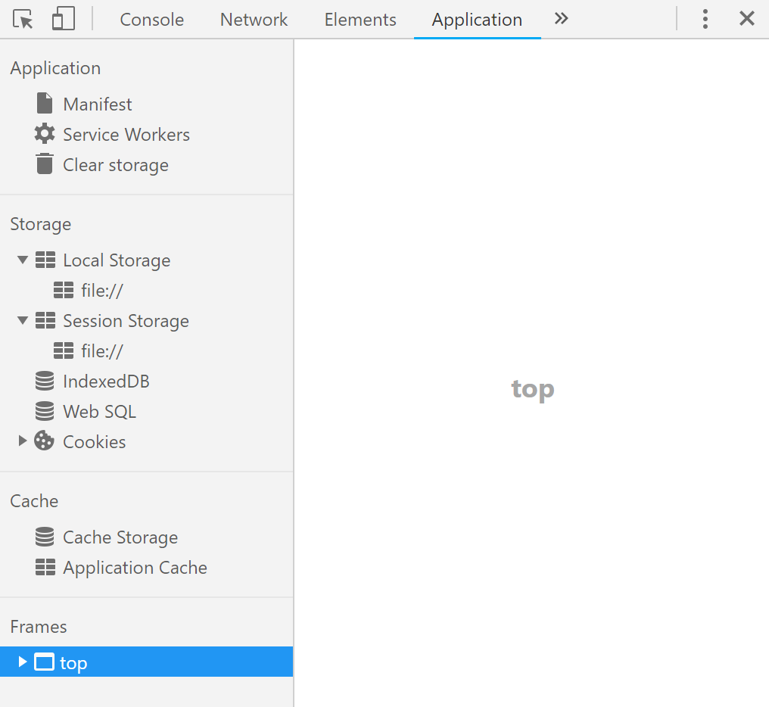
Tab Application

Slide 12
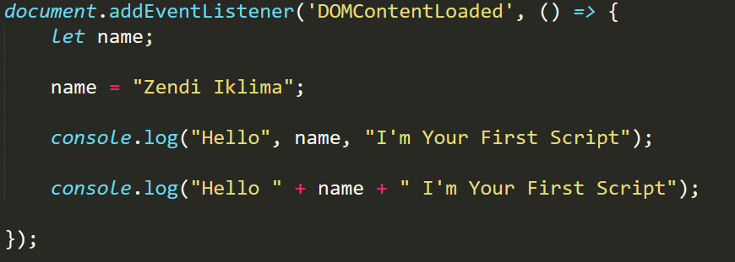
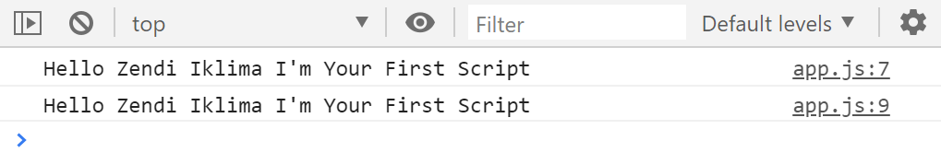
Variables (let)

Slide 13
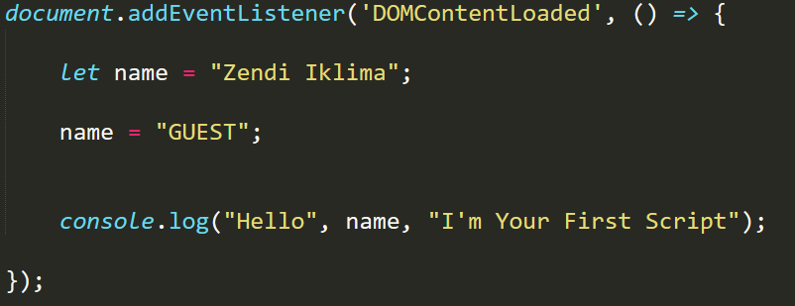
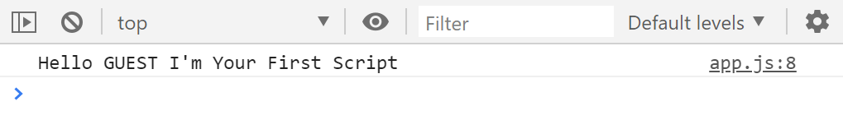
Variables (let)

Slide 14
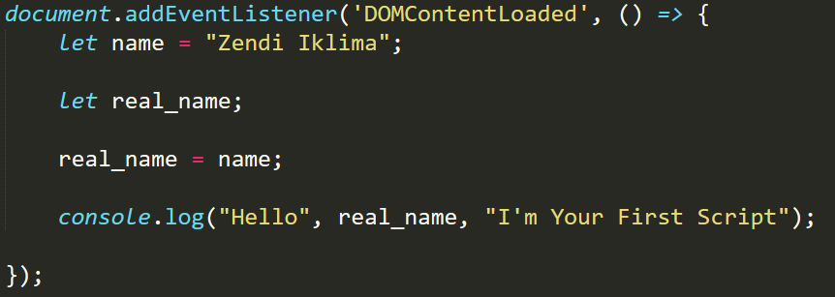
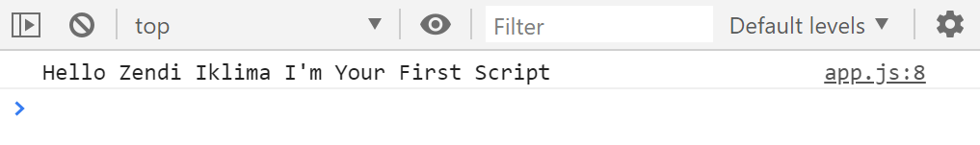
Variables (let)

Slide 15
Variables (let)
a variable can be defined with string, simbol, and number for example let test_1; let name_20; etc.
But it has incorrect variables name started in number, example let 1a; let 2test; etc. and also with - example let test-2; should be let test_2;
It can be use non-english verbals
example: let 我是;
and also cant use reserved name for example let, class, return and function

Slide 16
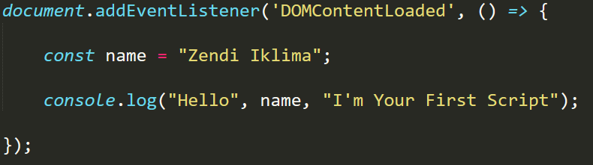
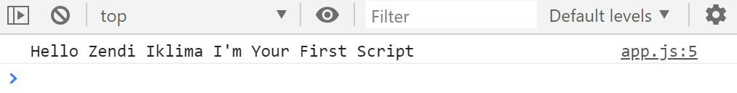
Variables (const)

Slide 17
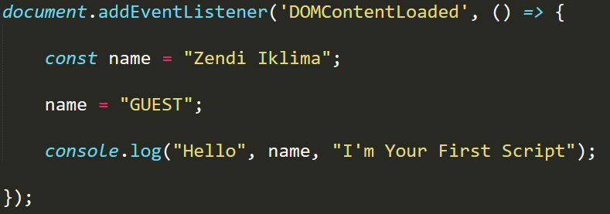
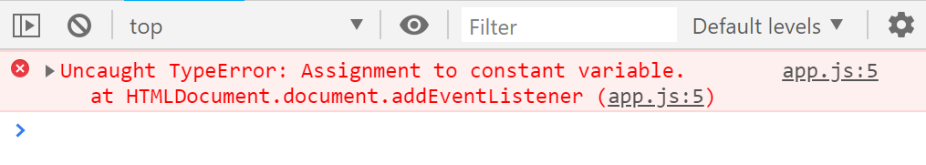
Variables (const)

Slide 18
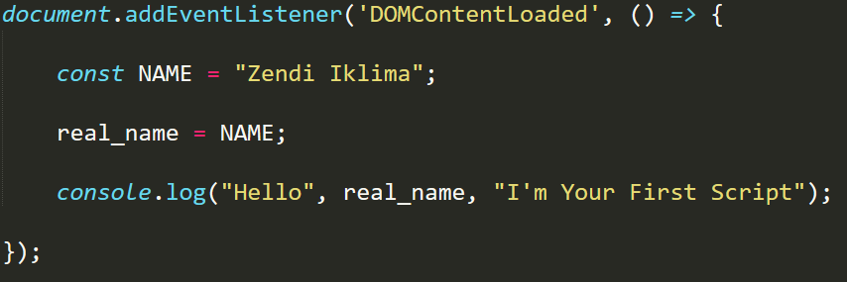
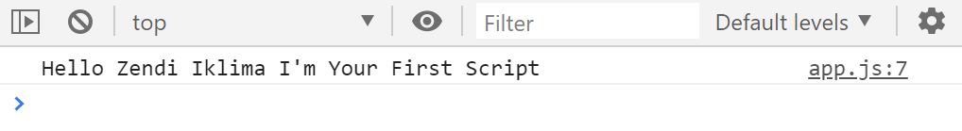
Variables (const)

Slide 19
Data Type
A variable in JavaScript can contain any data. A variable can at one moment be a string and at another be a number:
// no error
let text = "hello";
text = 123456;
text = 123.456;
console.log(text);

Slide 20
Data Type (Number)
There are many operations for numbers, e.g. multiplication *, division /, addition +, subtraction -, and so on.
Besides regular numbers, there are so-called “special numeric values” which also belong to this data type: Infinity, -Infinity and NaN.
console.log( 1 / 0 ); // Infinity
console.log( Infinity ); // Infinity
console.log( ‘text’ / 2 ); // NaN

Slide 21
Data Type (String)
A string in JavaScript must be surrounded by quotes.
let str = "Hello";
let str2 = 'Single quotes are ok too’;
let phrase = `can embed ${str}`;
In JavaScript, there are 3 types of quotes.
Double quotes: "Hello".
Single quotes: 'Hello'.
Backticks: `Hello`.

Slide 22
Data Type (String)
Double and single quotes are “simple” quotes. There’s no difference between them in JavaScript.
Backticks are “extended functionality” quotes. They allow us to embed variables and expressions into a string by wrapping them in ${…}, for example:
let name = "John";
// embed a variable
console.log( `Hello, ${name}!` );
// Hello, John! // embed an expression
console.log( `the result is ${1 + 2}` );
// the result is 3
console.log( "the result is ${1 + 2}" );
// the result is ${1 + 2} (double quotes do nothing)

Slide 23
Data Type (Boolean)
The boolean type has only two values: true and false.
This type is commonly used to store yes/no values: true means “yes, correct”, and false means “no, incorrect”. For instance:
let nameFieldChecked = true;
// yes, name field is checked
let ageFieldChecked = false;
// no, age field is not checked
Boolean values also come as a result of comparisons:
let isGreater = 4 > 1;
console.log( isGreater );
// true (the comparison result is "yes")

Slide 24
Data Type (null value)
The special null value does not belong to any of the types described above.
It forms a separate type of its own which contains only the null value:
let age = null;
In JavaScript, null is not a “reference to a non-existing object” or a “null pointer” like in some other languages.
It’s just a special value which represents “nothing”, “empty” or “value unknown”.
The code above states that age is unknown or empty for some reason.

Slide 25
Data Type (undefined)
The special value undefined also stands apart. It makes a type of its own, just like null.
The meaning of undefined is “value is not assigned”.
If a variable is declared, but not assigned, then its value is undefined:
let x; console.log(x); // shows "undefined“
Technically, it is possible to assign undefined to any variable:
let x = 123;
x = undefined;
console.log(x); // "undefined"

Slide 26
Type of Operator
The typeof operator returns the type of the argument. It’s useful when we want to process values of different types differently or just want to do a quick check.
It supports two forms of syntax:
As an operator: typeof x.
As a function: typeof(x).
In other words, it works with parentheses or without them. The result is the same.

Slide 27
Type of Operator
The call to typeof x returns a string with the type name:
typeof undefined // "undefined“
typeof 0 // "number“
typeof true // "boolean“
typeof "foo" // "string“
typeof Symbol("id") // "symbol“
typeof Math // "object" (1)
typeof null // "object" (2)
typeof alert // "function" (3)

Slide 28
Summary
Here are 7 basic types in JavaScript.
number for numbers of any kind: integer or floating-point.
string for strings. A string may have one or more characters, there’s no separate single-character type.
boolean for true/false.
null for unknown values – a standalone type that has a single value null.
undefined for unassigned values – a standalone type that has a single value undefined.
object for more complex data structures.
symbol for unique identifiers.
The typeof operator allows us to see which type is stored in a variable.
Two forms: typeof x or typeof(x).
Returns a string with the name of the type, like "string".
For null returns "object" – this is an error in the language, it’s not actually an object.
In the next chapters, we’ll concentrate on primitive values and once we’re familiar with them, we’ll move on to objects.

Slide 29
Tasks
What is the output of the Script?
let name = “GUEST";
alert( `hello ${1}` ); // ?
alert( `hello ${"name"}` ); // ?
alert( `hello ${name}` ); // ?

Slide 30
Tasks
let name = “GUEST";
alert( `hello ${1}` );
// hello 1
alert( `hello ${"name"}` );
// hello name
alert( `hello ${name}` );
// hello GUEST

Slide 31
Type of Convertion (ToString)
String conversion happens when we need the string form of a value.
For example, alert(value) does it to show the value.
We can also call the String(value) function to convert a value to a string:
let value = true;
console.log(typeof value); // Boolean
value = String(value);// now value is a string "true“
console.log(typeof value); // string
String conversion is mostly obvious. A false becomes "false", null becomes "null", etc.
Notes:
https://javascript.info/type-conversions

Slide 32
Type of Convertion (ToNumber)
Numeric conversion happens in mathematical functions and expressions automatically. For example, when division / is applied to non-numbers:
console.log( "6" / "2" );// 3, strings are converted to numbers
We can use the Number(value) function to explicitly convert a value to a number:
let str = "123";
console.log(typeof str);// string
let num = Number(str);// becomes a number 123
console.log(typeof num);// number
Explicit conversion is usually required when we read a value from a string-based source like a text form but expect a number to be entered. If the string is not a valid number, the result of such a conversion is NaN. For instance:
let age = Number("an arbitrary string instead of a number");
console.log(age); // NaN, conversion failed
Notes:
https://javascript.info/type-conversions

Slide 33
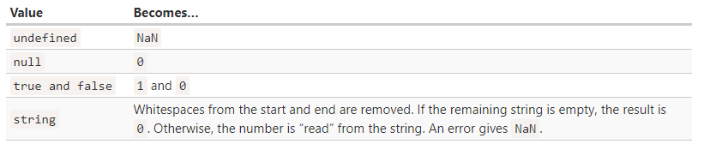
Type of Convertion (ToNumber)
Rules:
Example:
console.log( Number(“ 123 ") ); // 123
console.log( Number(“123z") ); // NaN
console.log( Number(true) ); // 123
console.log( Number(false) ); // 123
console.log( 1 + ‘2’ ); // ’12’
console.log( ‘2’ + 1 ); // ’12’
Notes:
https://javascript.info/type-conversions

Slide 34
Type of Convertion (ToBoolean)
Boolean conversion is the simplest one.
It happens in logical operations (later we’ll meet condition tests and other similar things) but can also be performed explicitly with a call to Boolean(value).
The conversion rule:
Values that are intuitively “empty”, like 0, an empty string, null, undefined, and NaN, become false.
Other values become true.
For instance:
console.log( Boolean(1) ); // true
console.log( Boolean(0) ); // false
console.log( Boolean("hello") ); // true
console.log( Boolean("") ); // false
console.log( Boolean("0") ); // true
console.log( Boolean(" ") ); // spaces (non-empty string is true)
Notes:
https://javascript.info/type-conversions

Slide 35
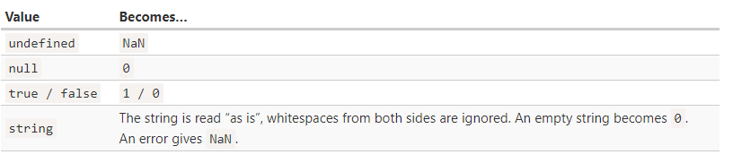
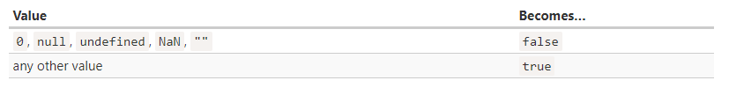
Summary
Notes:
https://javascript.info/type-conversions

Slide 36
Tasks
What are results of these expressions?
"" + 1 + 0
"" - 1 + 0
true + false
6 / "3“
"2" * "3“
4 + 5 + "px“
"$" + 4 + 5
"4" – 2
"4px" – 2
7 / 0
" -9 " + 5
" -9 " – 5
null + 1
undefined + 1
Notes:
https://javascript.info/type-conversions

Slide 37
Tasks
"" + 1 + 0 = "10" // (1)
"" - 1 + 0 = -1 // (2)
true + false = 1
6 / "3" = 2
"2" * "3" = 6
4 + 5 + "px" = "9px"
"$" + 4 + 5 = "$45"
"4" - 2 = 2
"4px" - 2 = NaN
7 / 0 = Infinity
" -9 " + 5 = " -9 5" // (3)
" -9 " - 5 = -14 // (4)
null + 1 = 1 // (5)
undefined + 1 = NaN // (6)
Notes:
1. The addition with a string "" + 1 converts 1 to a string: "" + 1 = "1", and then we have "1" + 0, the same rule is applied.
2. The subtraction - (like most math operations) only works with numbers, it converts an empty string "" to 0.
3. The addition with a string appends the number 5 to the string.
4. The subtraction always converts to numbers, so it makes " -9 " a number -9(ignoring spaces around it).
5. null becomes 0 after the numeric conversion.
6. undefined becomes NaN after the numeric conversion.

Slide 38
Zendi Iklima ST, SKom, MSc

